Slide 1
Reducing Energy Costs Using Thermal Mass in Refrigerator
ME-195B
Isabel Price, Kalino Ruiz, Caleb Mok, Brent Marin, Matthew Manuel
Dr. Keith Yi
Mechanical Engineering Department
San Jose State University
12/8/2025

Slide 2

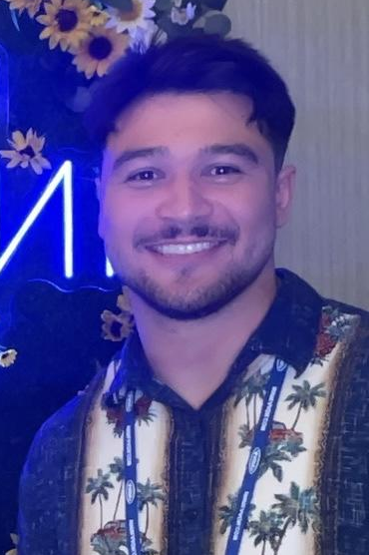


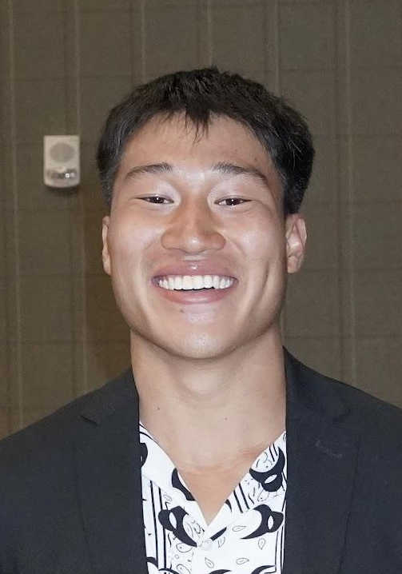

MEET THE TEAM
Kalino Ruiz
Brent Marin
Isabel Price
Caleb Mok
Matthew Manuel

Slide 3
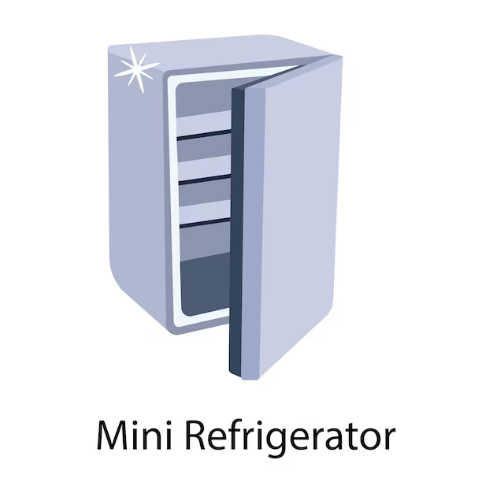
OUTLINE
Motivation and Background
Literature Review
Objectives and Specifications
Design
Theory
Electronics
Code
System Performance
Prototype
Video
Conclusions
Ethical/Societal/etc considerations
Lessons Learned
Future Work
References
Acknowledgement

Slide 4
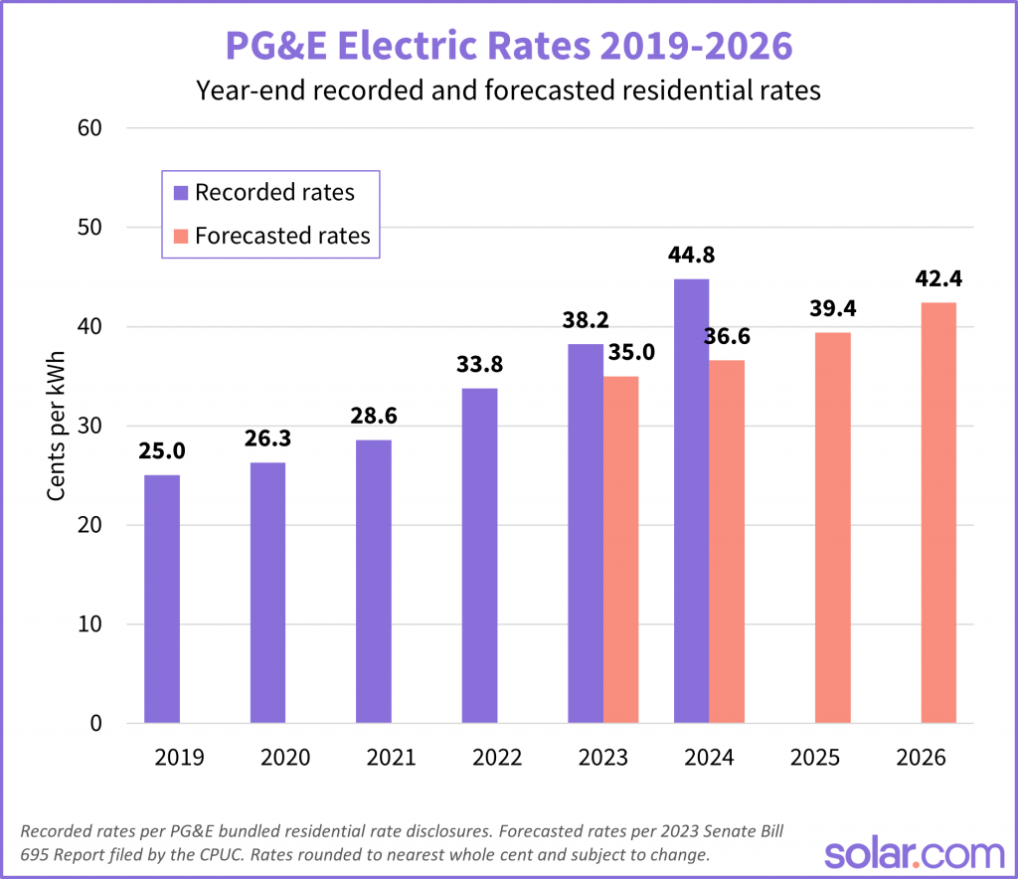
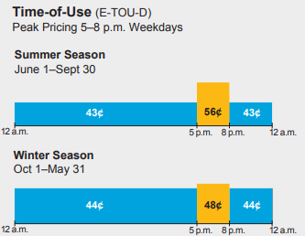
MOTIVATION AND BACKGROUND
Electricity is Expensive!
PG&E has raised price for Energy by 50% in 5 years
Prices will continue to rise
Modern appliances all
shifting away from gas
Presented by: Caleb Mok

Slide 5
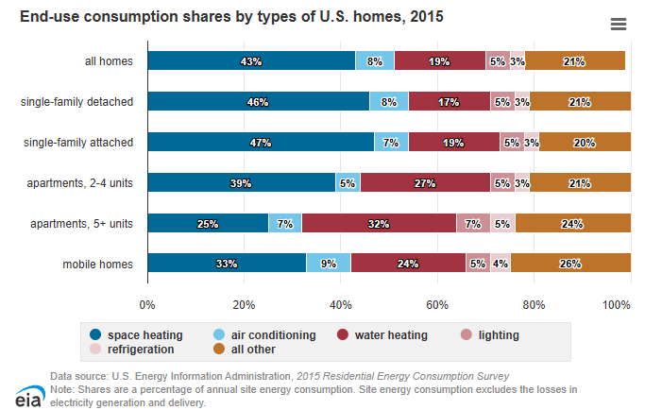
MOTIVATION AND BACKGROUND
Why Refrigerators?
Everybody has a refrigerator
refrigerators consist of roughly 3-5% of household energy
This doubles if a household has multiple units
Presented by: Caleb Mok

Slide 6
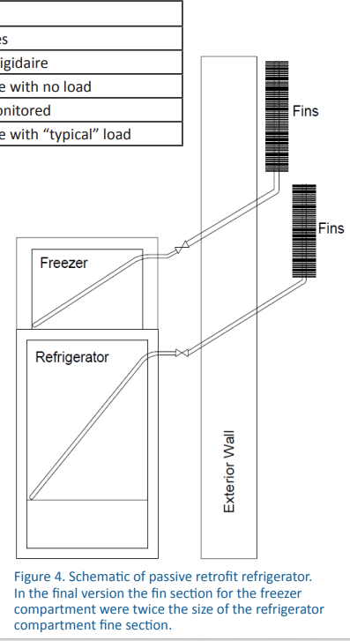
PASSIVE COOLING REFRIGERATOR PROTOTYPE
(Garber-Slaght, 2013)
Experiment compares passive and active refrigeration
Thermal fin model
Results
Good winter performance, bad summer performance
6.3 kWh (Passive model)
36.1 kWh (Active model)
Presented by: Brent Marin

Slide 7
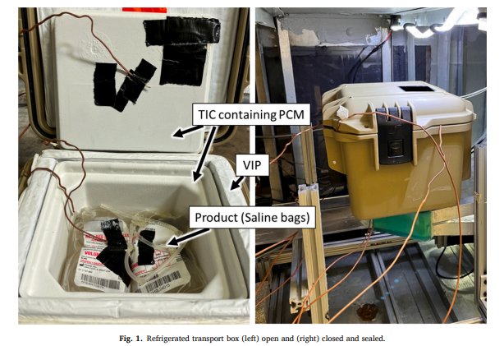
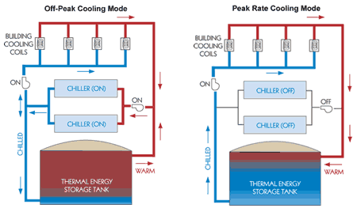
EXISTING PRODUCTS USING THERMAL MASS
Refrigerator Transport boxes
(Fauer and Cremaschi, 2024)
HVAC Application - Building AC
(Trane collaboration with Natgun, Ice Energy, and Calmac)
Successful in maintaining refrigerated temperature for duration of time
Reduces energy cost and carbon emissions by shifting electricity demand to off-peak
Presented by: Brent Marin
Notes:
Note that TIC thermal insulation chamber (Thermal isolation chamber)
PCM phase-change material (Phase change material)
VIP vacuum insulated panel (Vacuum insulation panel)

Slide 8
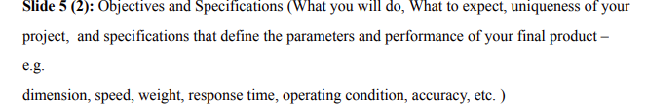
GENERAL PROJECT OBJECTIVES
Retrofit existing mini fridge to save money on electricity and reduce carbon emissions
Utilize thermal storage to shift load during peak time of use rates
Utilize a microcontroller to facilitate efficient fridge use
Presented by: Kalino Ruiz

Slide 9

SPECIFIC PROJECT SPECIFICATIONS
Keep refrigerator below 40°F at all times to be in line with basic FDA requirements
Create tangible energy/energy cost savings
Direct airflow from the fins for even cooling during the passive cycle
Presented by: Kalino Ruiz

Slide 10
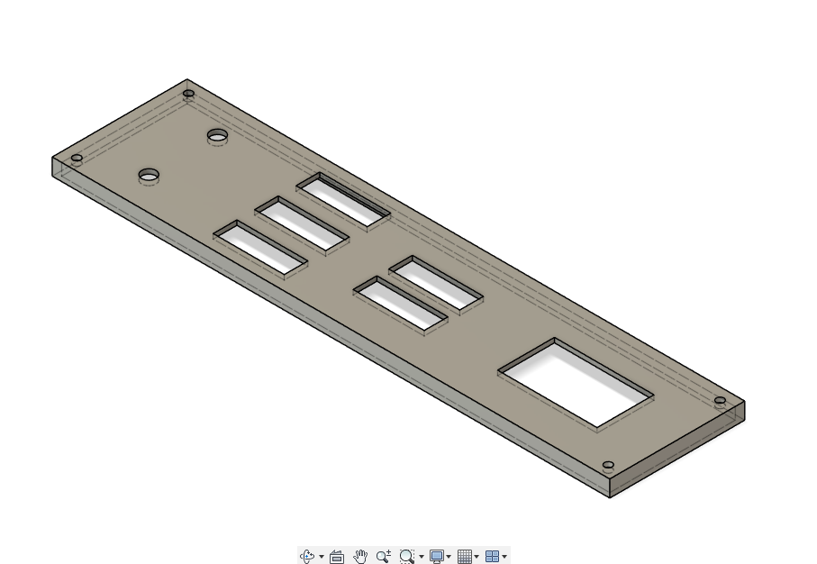
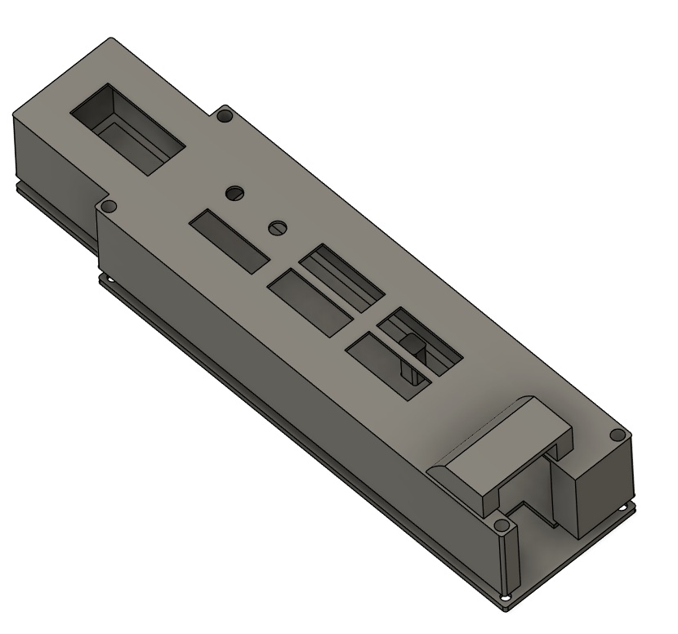
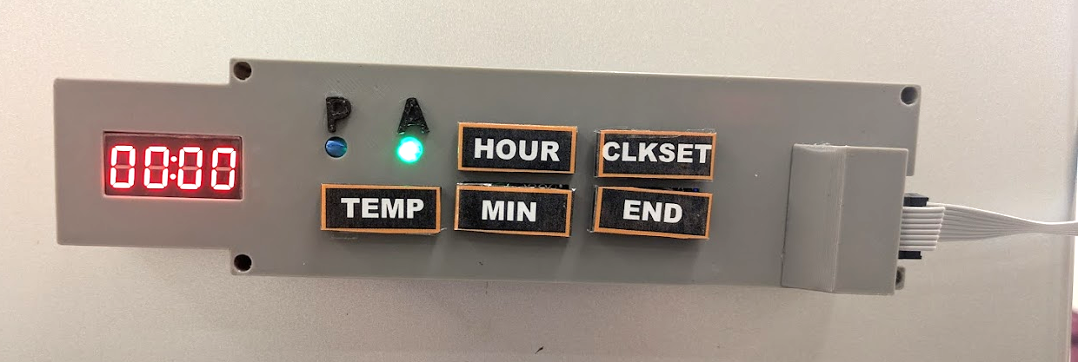
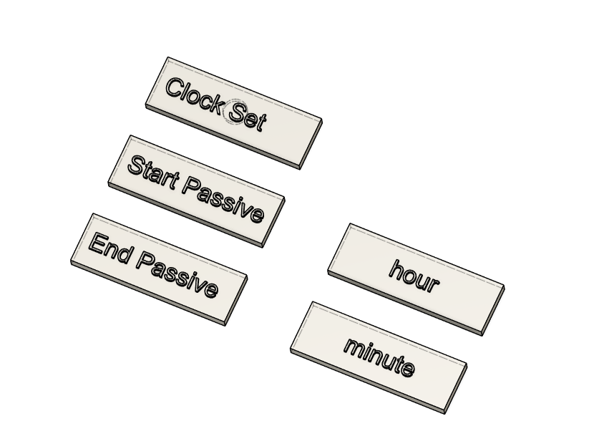
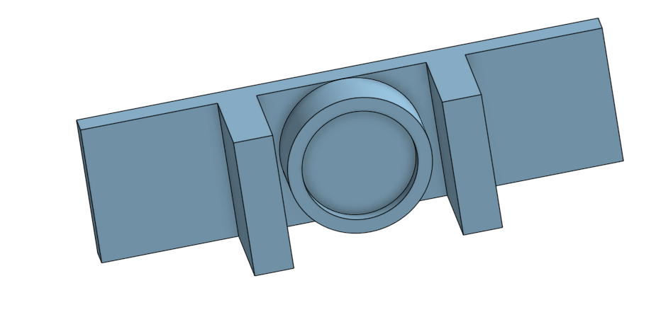
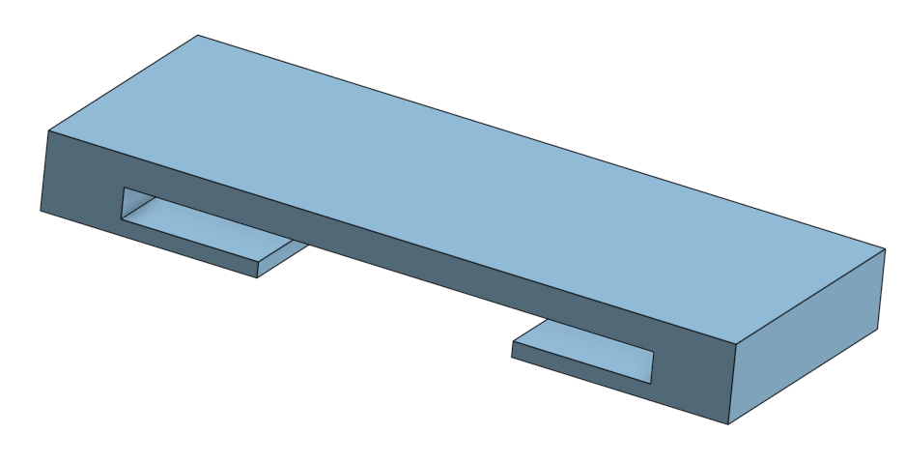
CONTROL PANEL DESIGN
Initial Design
Final Design
The goal for the control panel was to create an intuitive design for users
Focus on visibility and safety with all electronics safely encased and LEDs visible
Presented by: Kalino Ruiz

Slide 11
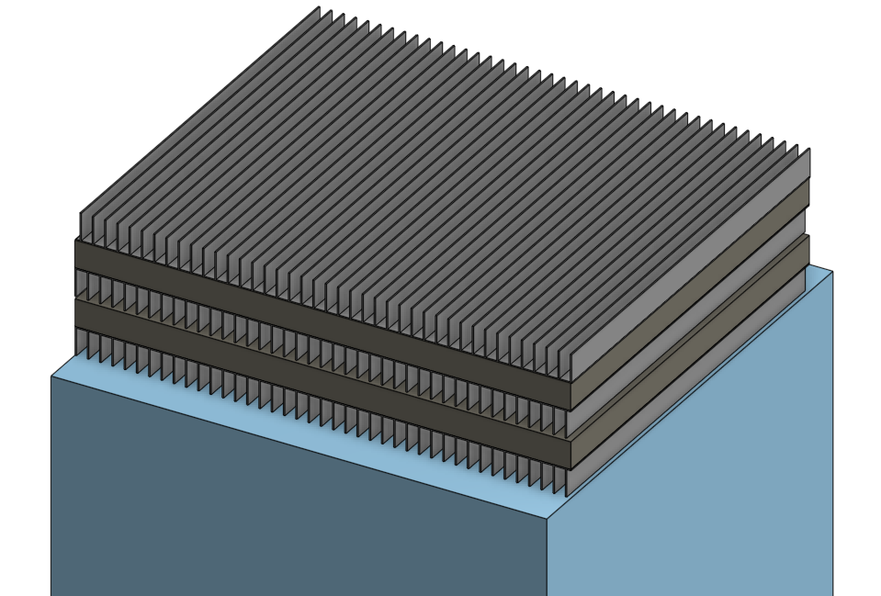
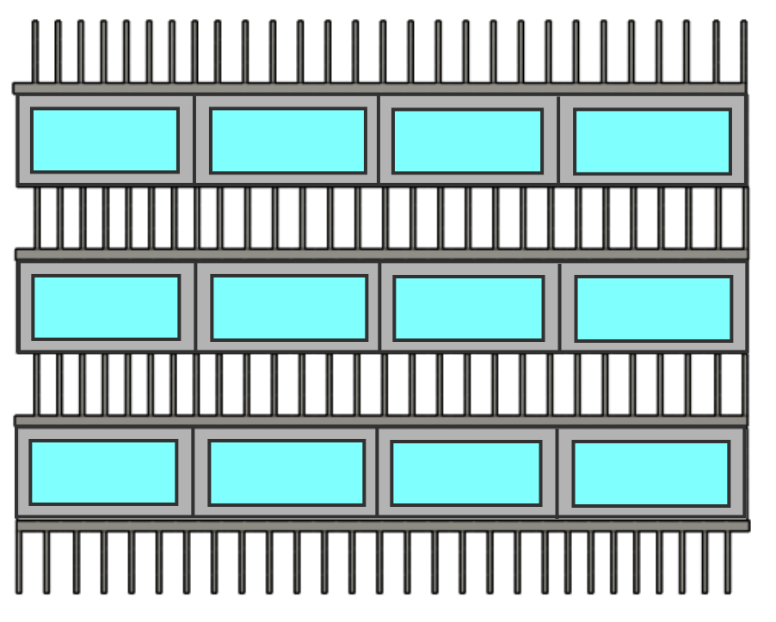
INITIAL HEAT SINK DESIGNS
Initial design 2: More refined iteration using aluminum square pipes to hold water/ice
Initial design 1: Horizontal fins+Ice blocks set on top of fridge for maximum space inside.
Presented by: Kalino Ruiz

Slide 12
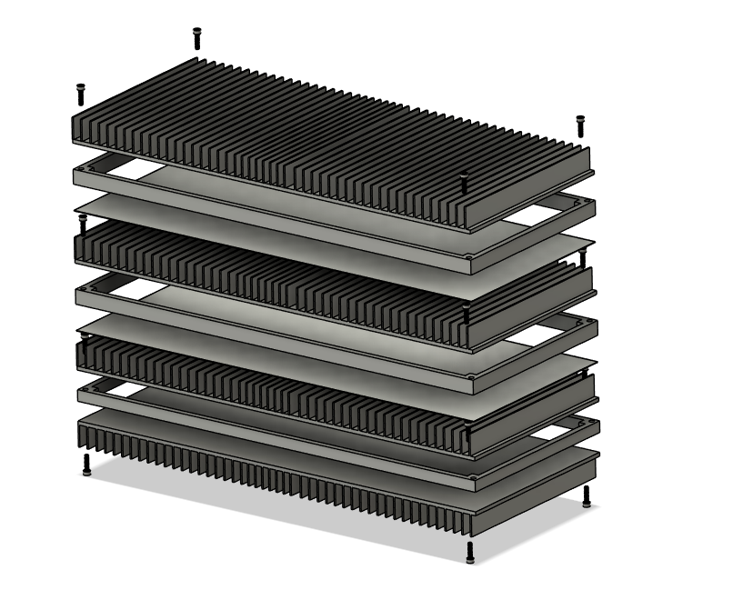
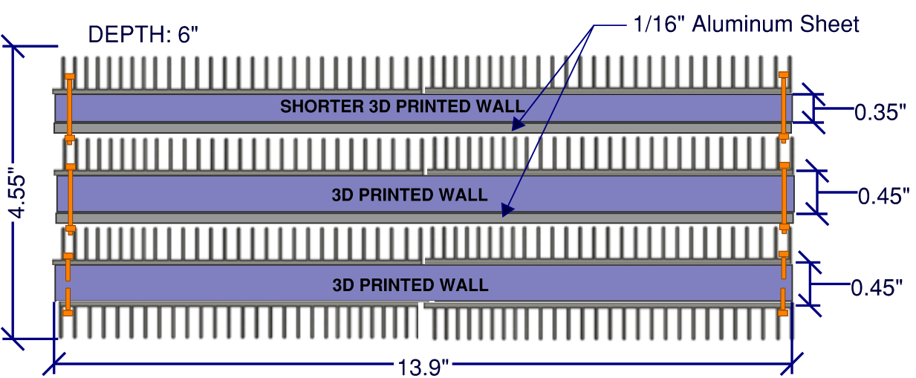
FINAL HEAT SINK DESIGN
Our final heat sink design uses 3D printed walls instead of aluminum to hold the ice
Additional considerations made for how the design would be fastened and sealed.
Presented by: Kalino Ruiz

Slide 13
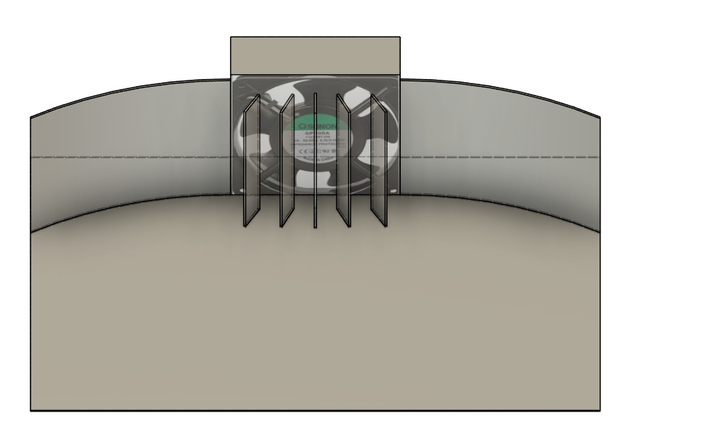
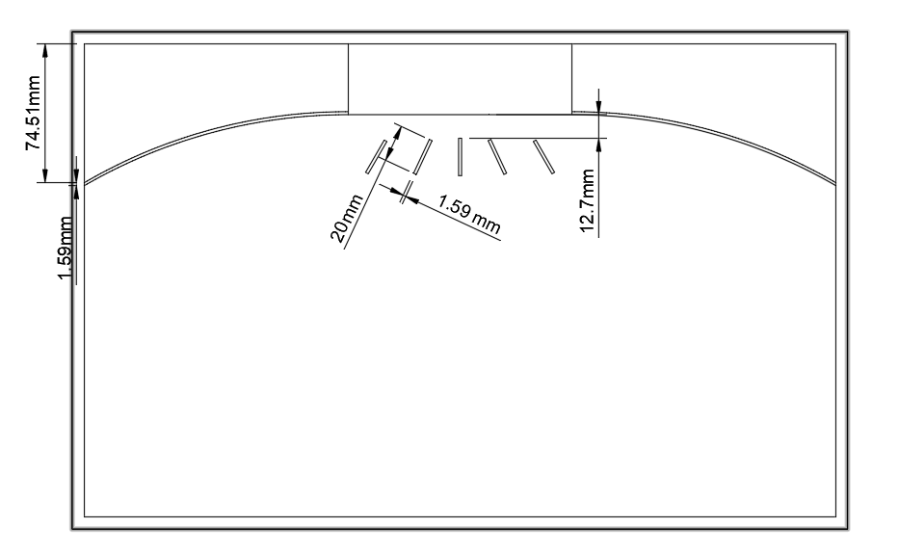
INITIAL FAN REGION DESIGNS
Made in tandem with initial heat sink design to facilitate optimized airflow
The design above was the first iteration with wings on both sides. This design had good merits but was impractical due to the central location of the fan and the angled fins in front of the fan disrupting airflow rather than helping distribute it.
Presented by: Kalino Ruiz

Slide 14
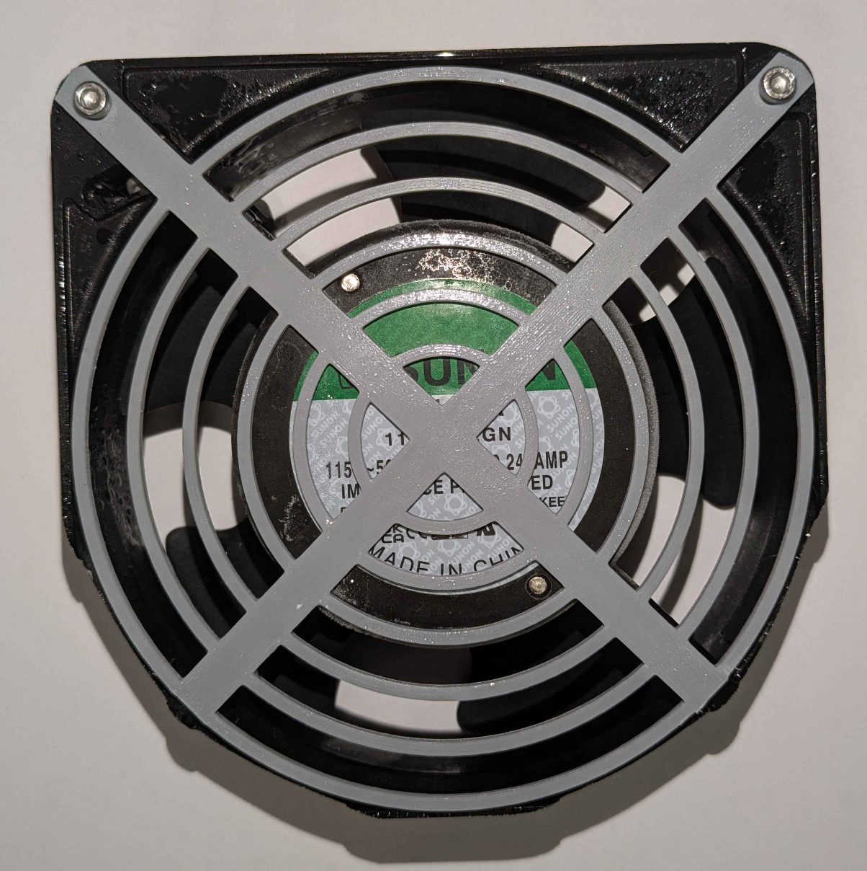
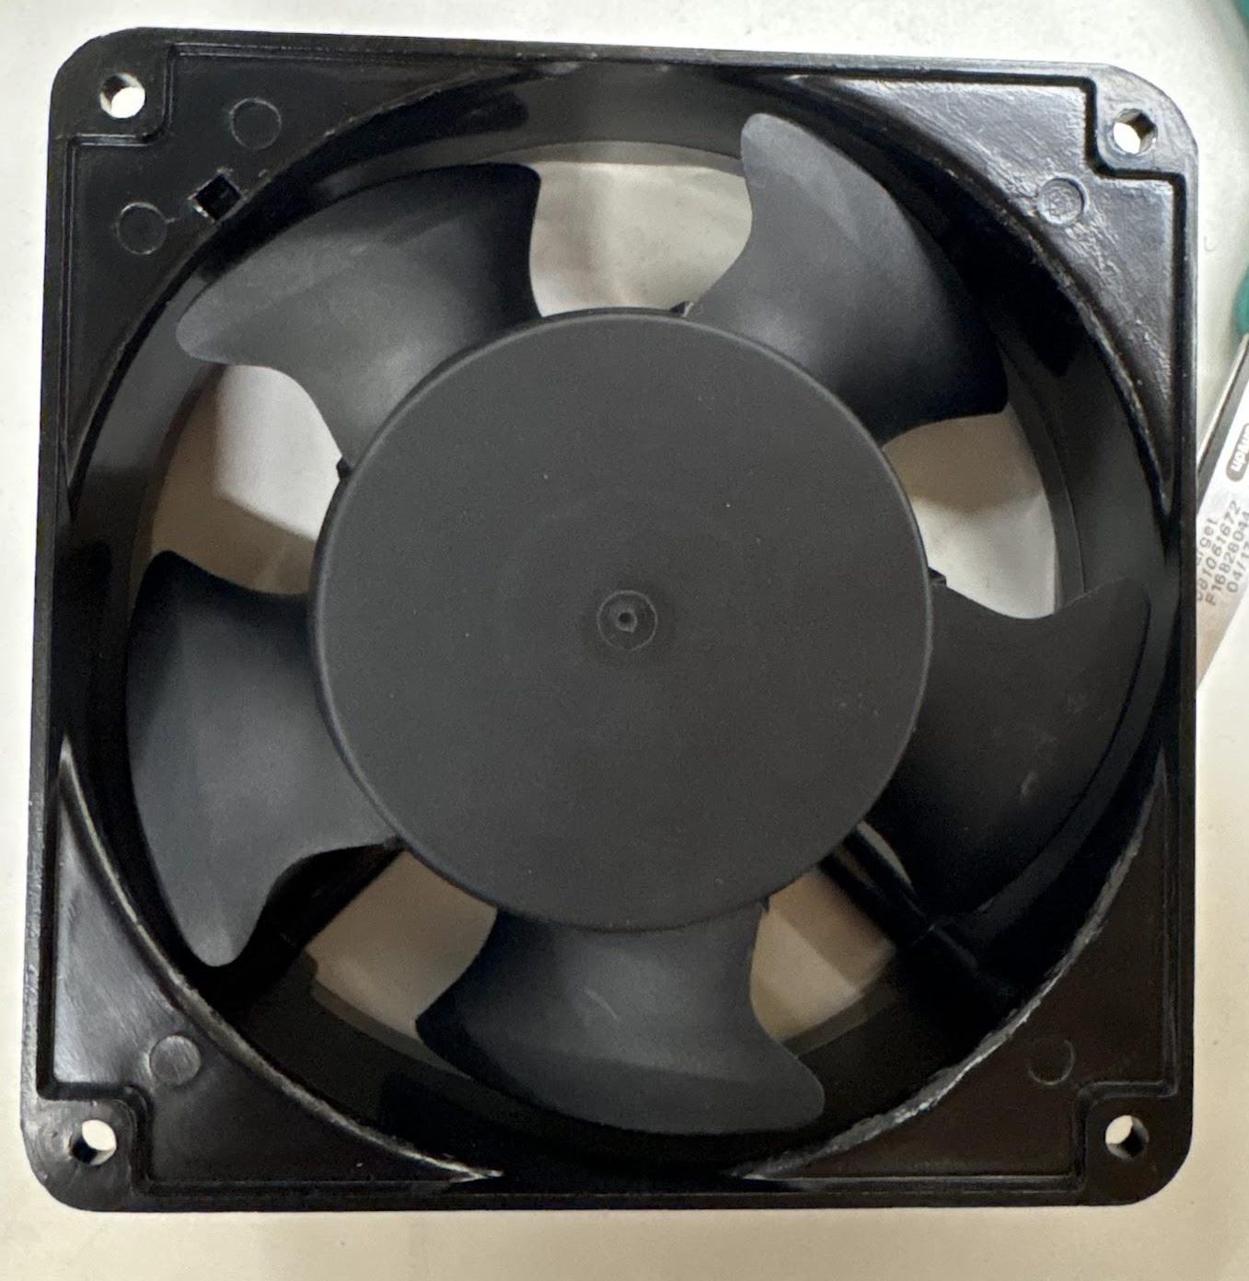
FINAL FAN REGION DESIGN
Cutting the Evaporator coil was too risky/difficult
Took advantage of hole already present
Maximized space, reduced static pressure
Fan
Back of Evaporator
Airflow Director
Ice Casing Assembly
Presented by: Caleb Mok

Slide 15
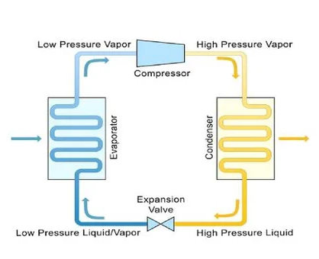
THEORY OF OUR REFRIGERATOR’S ACTIVE CYCLE
Vapor Compression Cycle
Hot air rises within the refrigerator
Hot air boils liquid refrigerant into vapor (evaporator coils on freezer shelf)
Heat is absorbed, vapor is compressed, and then rejected out of the condenser
Active Refrigeration Cycle
Presented by: Brent Marin

Slide 16
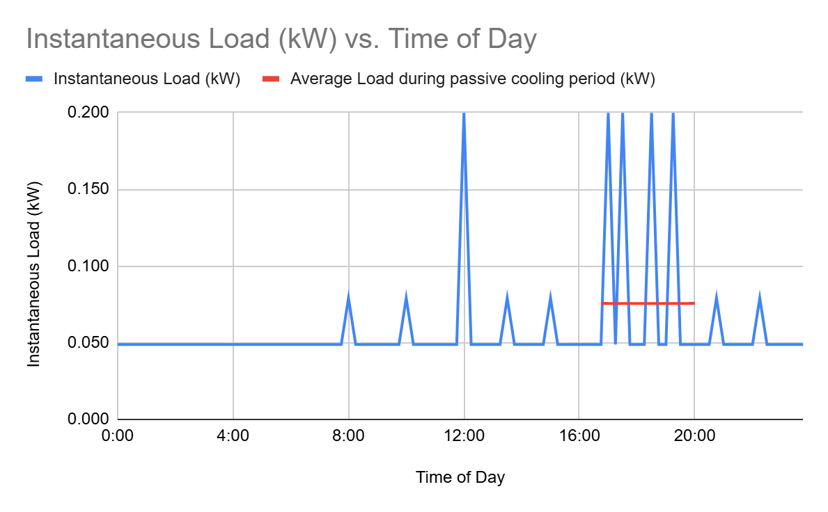
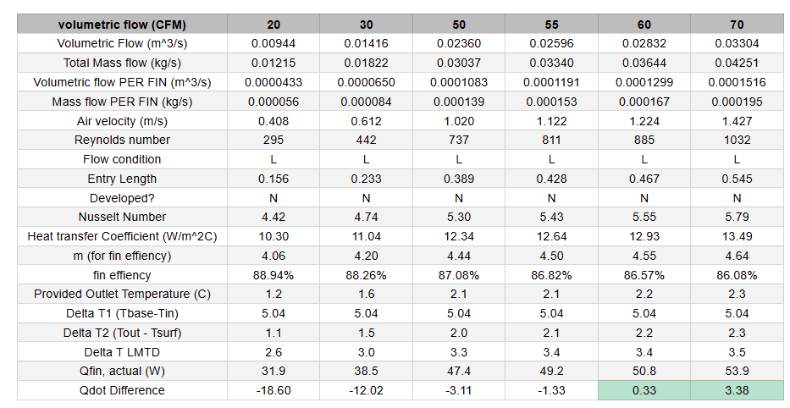
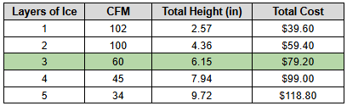
HEAT TRANSFER CALCULATIONS - HEAT SINK SELECTION CRITERIA
Initial Proposed Heat Load: 51 W
12 oz containers of water (20 qty) over 3 hours
Presented by: Isabel Price

Slide 17
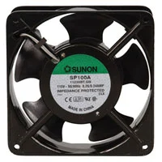
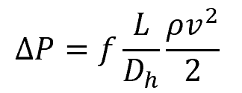
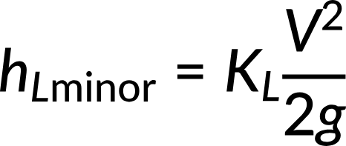
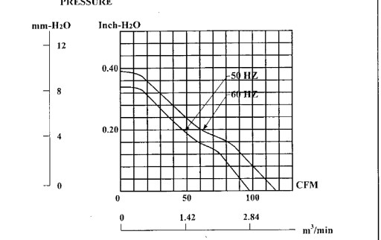
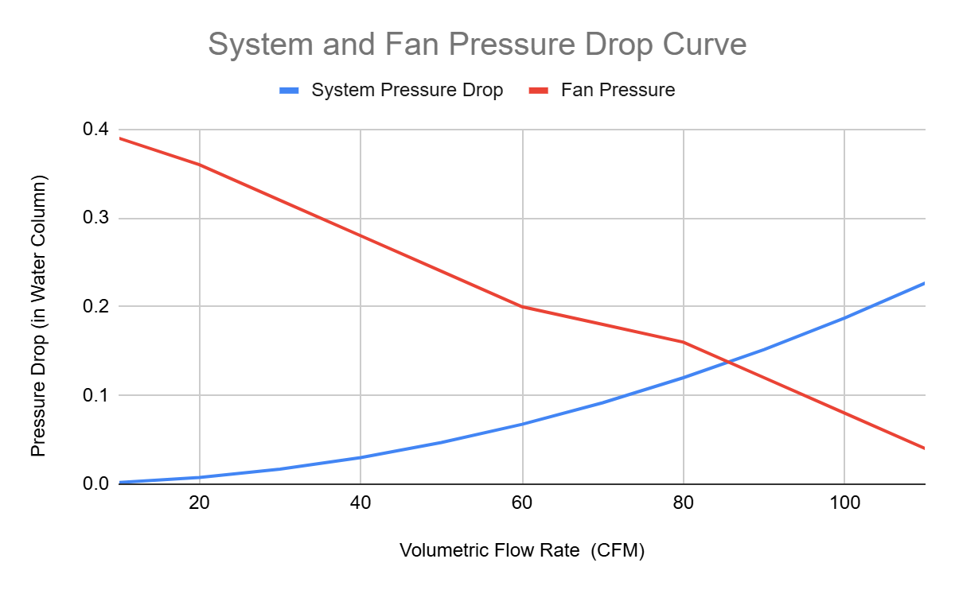
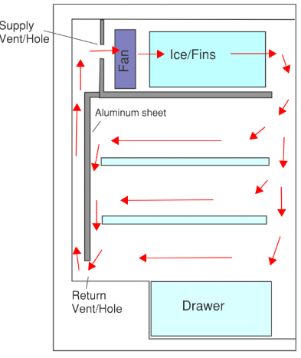
PRESSURE CALCULATIONS FOR FAN SELECTION
Skin Pressure Loss: Darcy-Weisbach Equation
Fitting Loss Coefficient:
Fan Specifications:
Voltage - 115 VAC
Power - 20 W
Max CFM - 117
Slide Assigned to: Isabel
Slide Content: Fan/Pressure Calcs
Presented by: Isabel Price

Slide 18
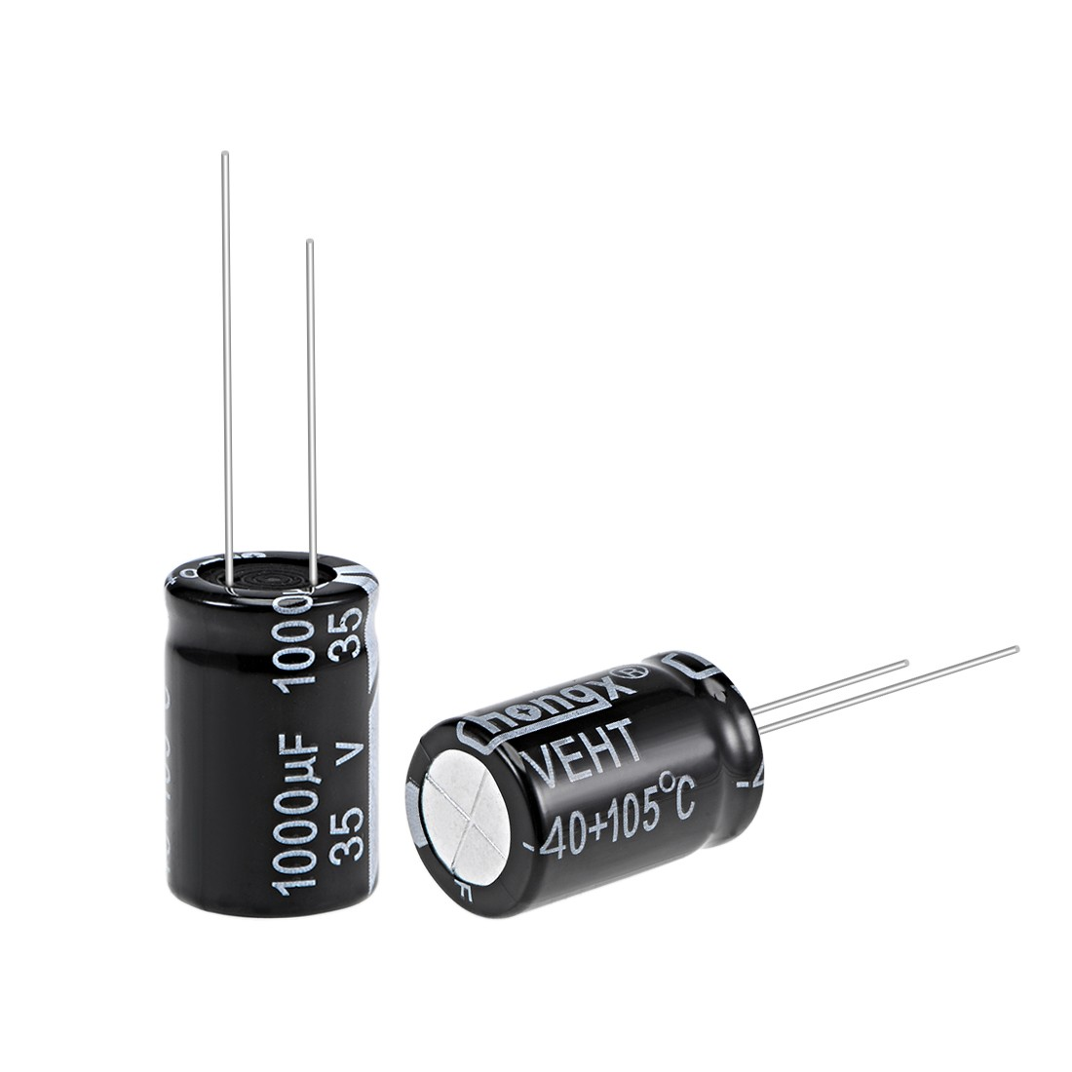
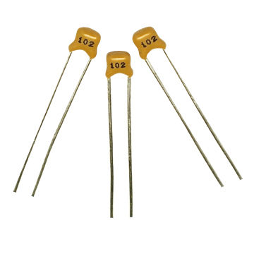
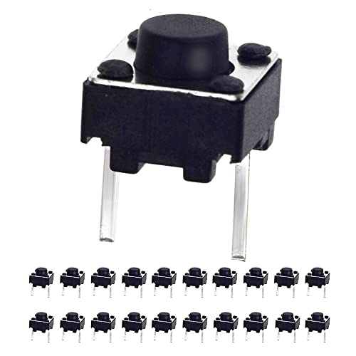
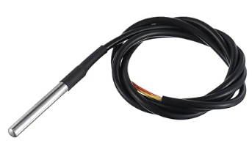
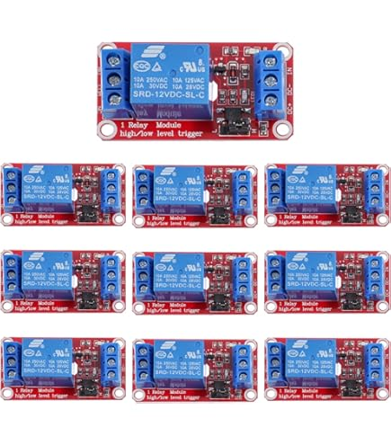
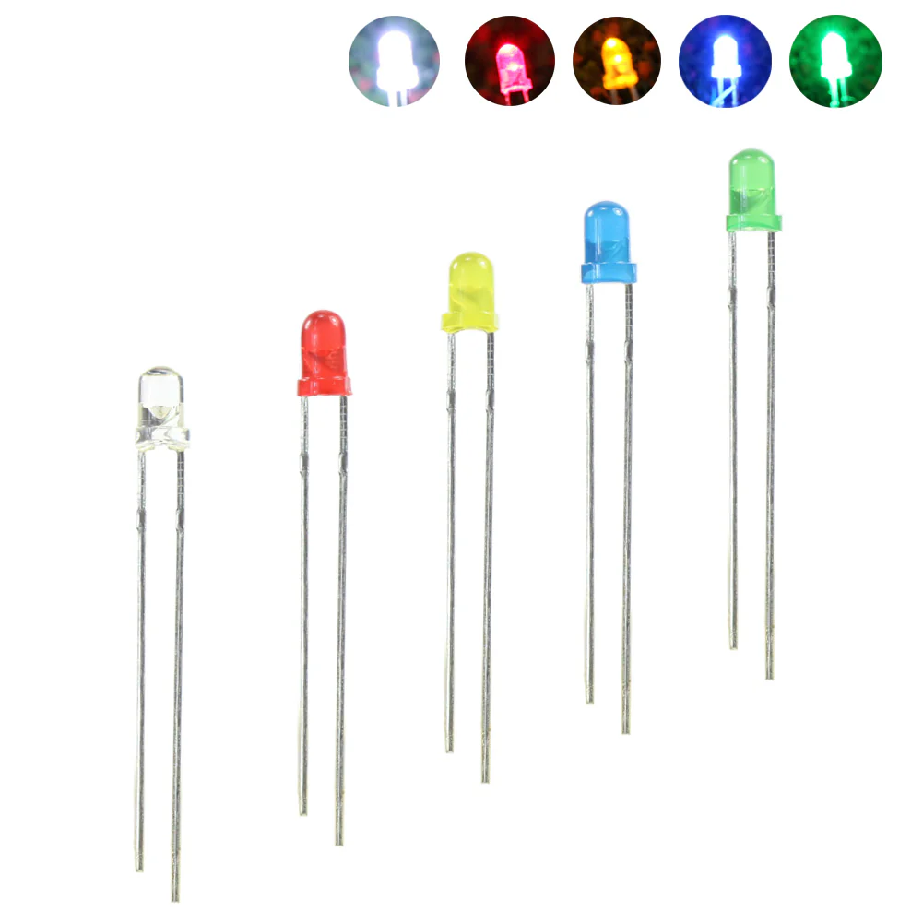
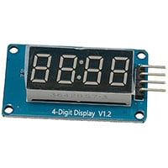
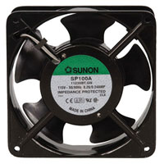
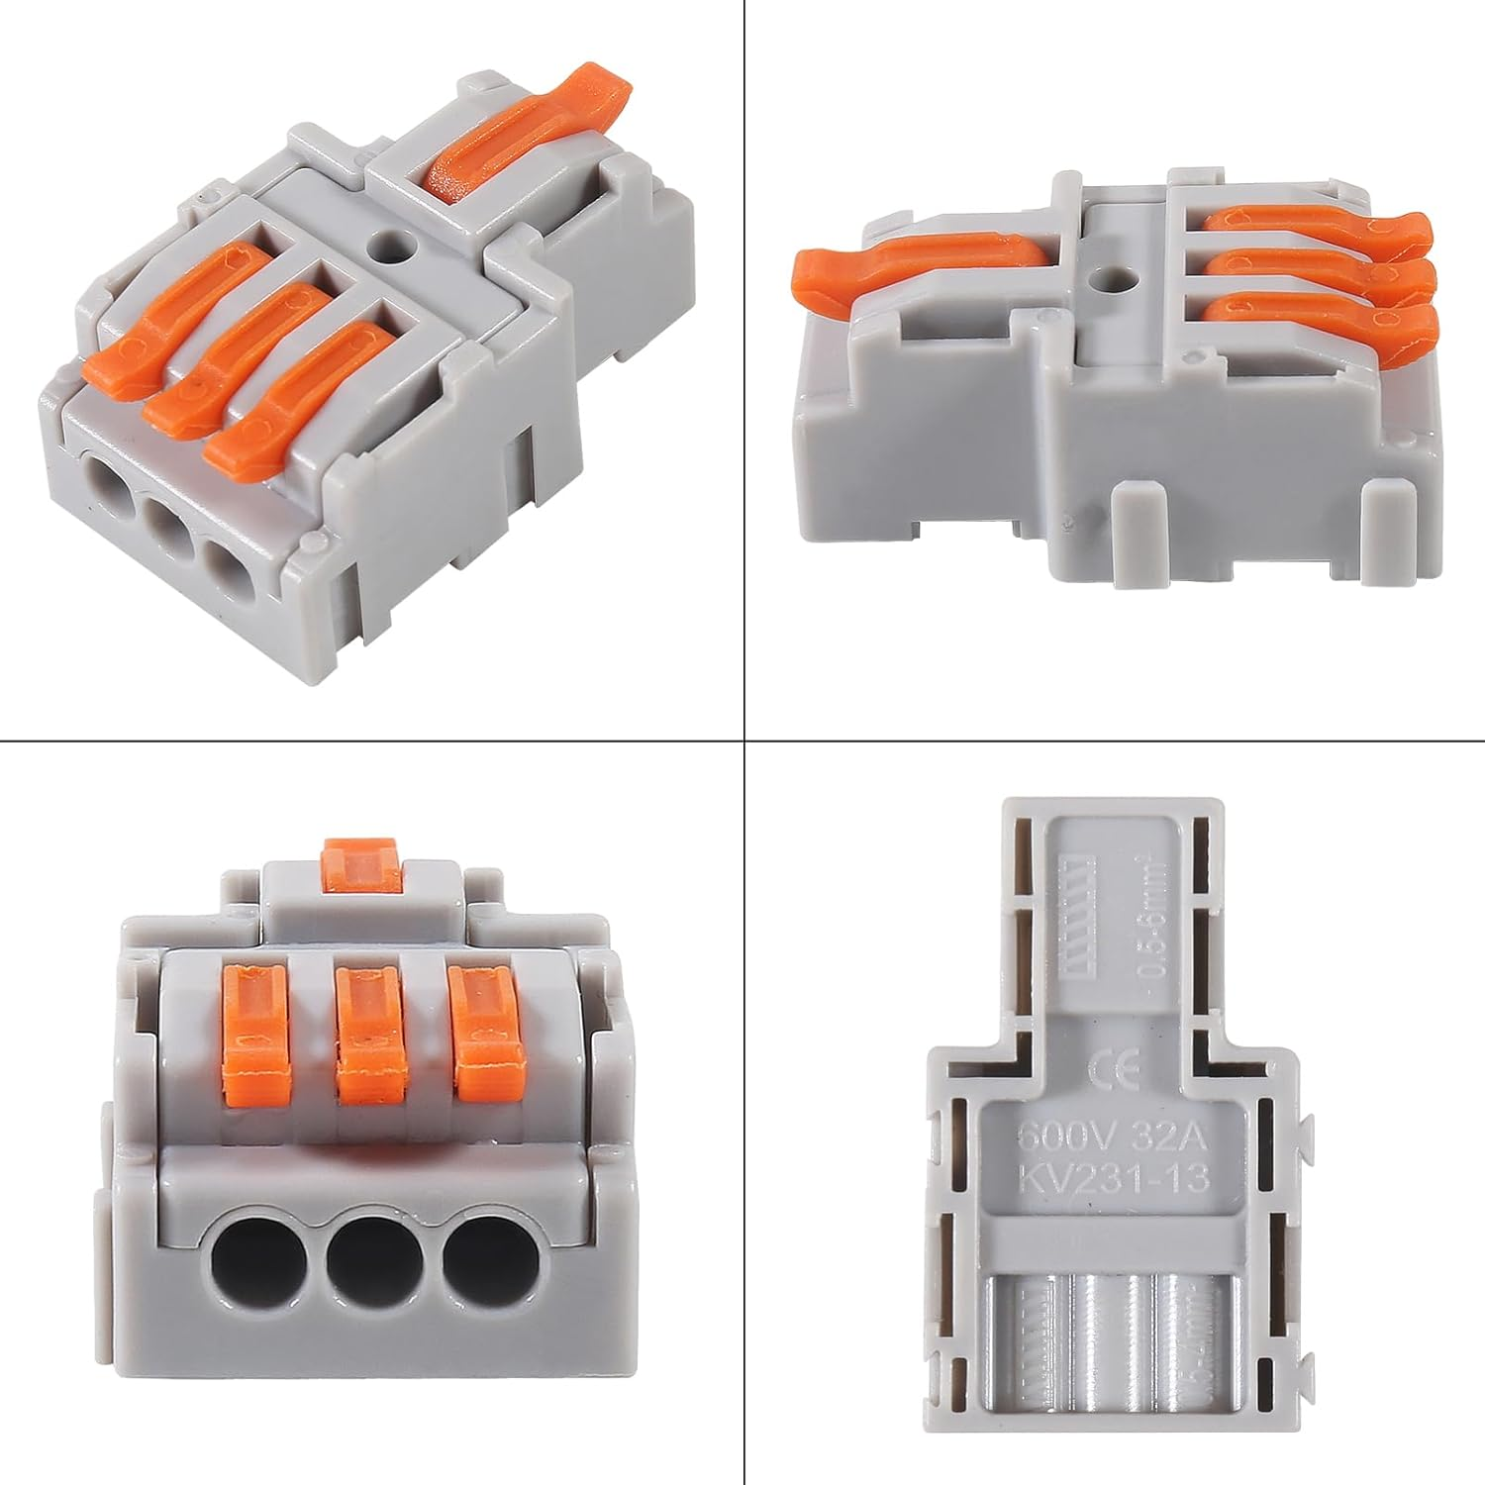
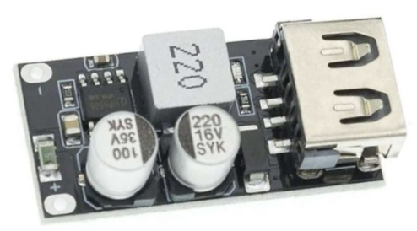
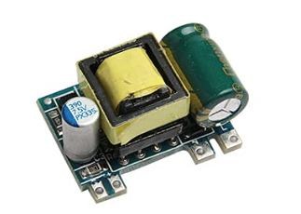
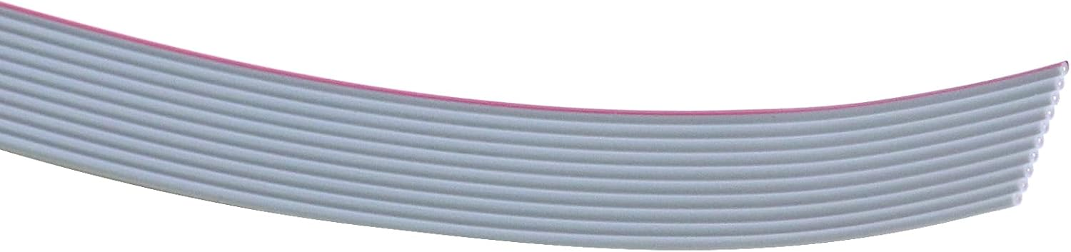

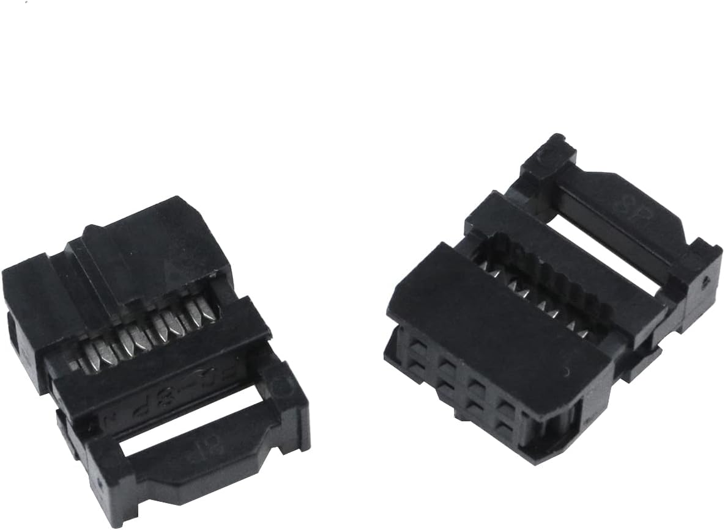
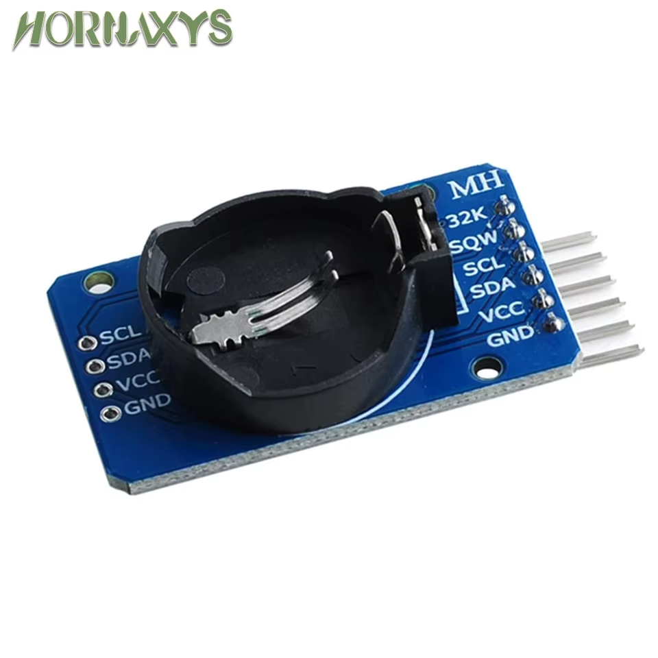
ELECTRONIC COMPONENT SELECTION
Integrated Circuit Temperature Sensor
±0.5°C Accuracy
-10°C to +85°C
5V One Channel Relay Module
Max 250V 10A AC
2 Pin Buttons
Capacitors
1000 µF Electrolytic
0.10 µF Ceramic
3mm LEDs
Ball Bearing Fan
115 VAC 60Hz
240mA 20W 117 CFM
TM1637 4-Bits Digital LED Display Module
3 Wire Splitter
Rated 32A 600V
DC to DC Buck Converter
Output 5V, 3.4A
Mini AC to DC converter
Input AC 50V-277V
Output: 5V 700mA DC
10 Wire Ribbon Cable
Female IDC Connector
RTC Memory Module
ESP32 NodeMCU
Presented by: Isabel Price

Slide 19
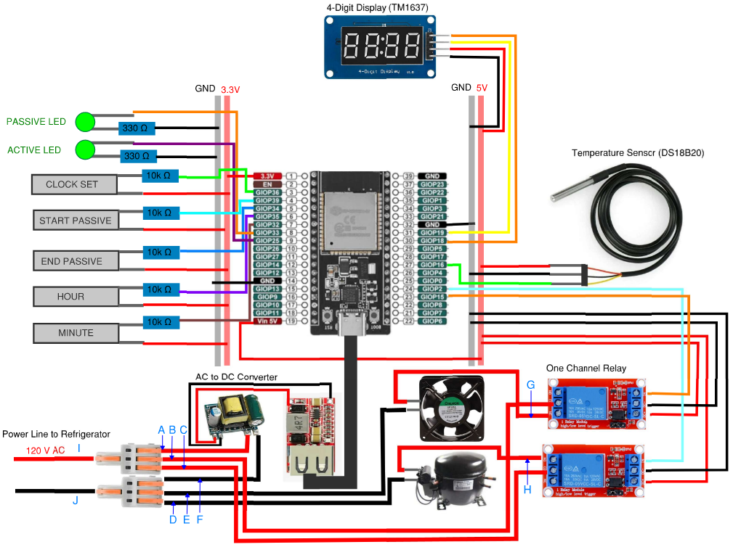
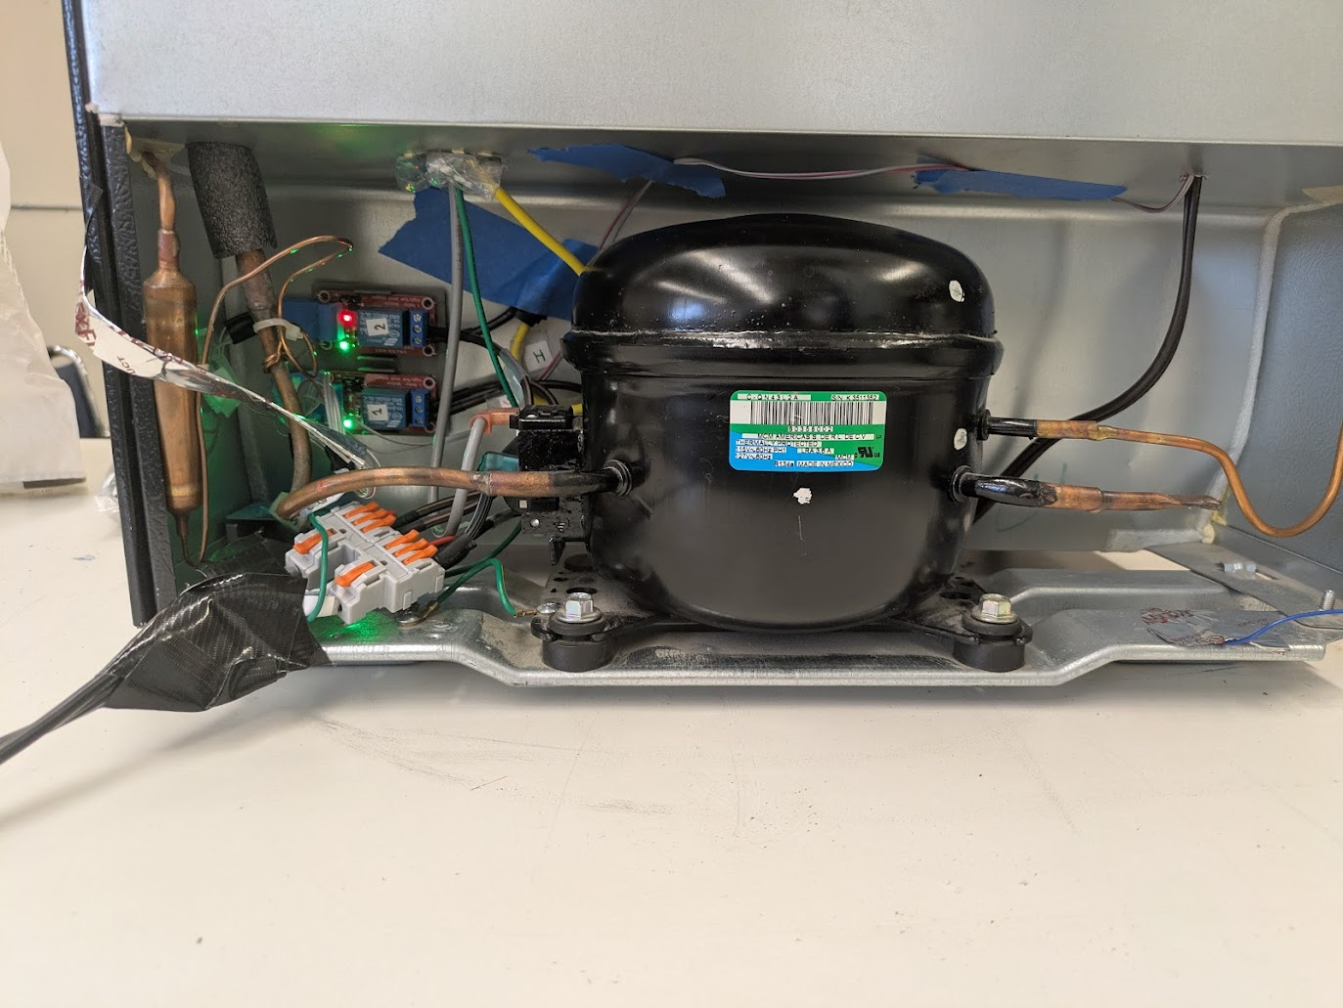
FULL REFRIGERATOR CIRCUITRY
Relays and AC to DC convertor stored with the compressor for resilience/safety
AC to DC converter completely encased
Ribbon cable encased in grounded aluminum tape to prevent electrical noise
Capacitors used to prevent brownouts
Presented by: Isabel Price

Slide 20






CONTROL PANEL PROTOBOARD DESIGN
Custom 90 Degree Angle for female IDC connector
Presented by: Isabel Price
Female header pins to allow ESP to be easily removed

Slide 21
CODING FLOWCHART
Start
Set Start Time
Press Clockset
Main features for customers
Set their own start time
Change the duration of the passive cycle
Automatically starts all over again the next day
Function of the code
uses buttons and 7-segment display for setting time and duration
real-time clock module (RTC) for triggering cycle
temperature sensor for automatic fan control
Yes
Set Duration Time
Press End
Yes
Start Passive Mode
Press End
Yes
Temp >40
Yes
Fan On
Temp < 37
No
Yes
Fan Off
Timer End
Yes
Restart @ Trigger Time
Presented by: Matthew Manuel

Slide 22


CODING
MAIN TRIGGER FUNCTION
Slide Assigned to: Matthew Slide Content: code stuff
RTC constantly reads the current time
triggers when the current time = start time
Turns off compressor and starts the (running) section of the code
mimics real clock countdown timer
calls toggleFan function as it counts down
turns on fan when it’s above 40 degrees
turns off fan when below 37 degrees
Presented by: Matthew Manuel

Slide 23



FLOW PROFILE MEASUREMENT AND ANALYSIS
Average Velocity: 1.14 m/s
Expected Velocity: 1.7 m/s
Approximate Flow Rate (Only include fin area): 45 CFM
Expected Flow Rate: 85 CFM
Hotwire Anemometer used to measure velocity
Presented by: Caleb Mok

Slide 24



TEMPERATURE PROFILE AND ENERGY CONSUMPTION - HOBO LOGGERS
Peak in energy to freeze assembly
Fan Power (22 W)
Jumps between Fan and Idle
Idle Power (0.8 W)
Plug Load Logger - Records Voltage/Current/Power vs Time
Temperature/RH Logger - Records temperature and relative humidity vs time
Presented by: Isabel Price

Slide 25


ENERGY CONSUMPTION RESULTS
Annual Savings (Coldest Refrigerator Setting)
Load shifted form peak: 29.7 kWh
Cost savings: $12.93
Annual Savings (3/5 Coldeness Setting)
Load shifted from peak: 13.0 kWh
Cost Savings: $4.29
Temperature above 41°F 21% of the time
December 5th Passive Period: 11:20-2:20 pm
Presented by: Isabel Price

Slide 26



PROTOTYPE: FREEZER PORTION
Freezer Layout
Ice Casing Assembly
Presented by: Caleb Mok
Inside of Fridge

Slide 27



PROTOTYPE DIFFICULTIES
Waterproofing Ice Casings
Brown outs with the AC/DC Converter
Transportation discrepancies
Disconnected Wires from Transportation
Inside of Casing
Presented by: Caleb Mok

Slide 28

VIDEO OF WORKING SMART REFRIGERATOR
Presented by: Brent Marin

Slide 29
CONCLUSIONS
The fan successfully cycles on when the temperature is above 41°F until the chamber temperature lowers to 37°F.
Prototype saves between $5-$12 a year in energy cost
Prototype offloads between 13-30 kWh a year
Measured average airflow between fins (1.14 m/s)
Calculated total airflow through ice casing assembly (45 CFM, calculated 85 CFM)
Presented by: Caleb Mok

Slide 30

REDUCING LOAD ON POWER GRID FOR USER SAVINGS AND THE ENVIRONMENT
Saves money for the user
High utility rate periods have a greater carbon footprint because of the need to turn on extra power plants
Small steps towards energy efficiency and a healthier environment
Presented by: Brent Marin

Slide 31
LESSONS LEARNED
Planning out the fabrication procedure earlier would’ve caught technical and regulatory constraints before it’s too late
AC dips can cause unreliable operation
Testing the power supply under load is important
Condensation leads to significant frost buildup due to moisture in the air
Working with a mini refrigerator was significantly more difficult
Doesn’t have separate freezer section
Presented by: Matthew Manuel

Slide 32
FUTURE WORK/IMPROVEMENT
Repeating design with a larger refrigerator with a separated freezer/refrigerator chamber
Reducing time above 40° F during passive cycle time and under 32 degrees during active cycle
Testing different fan layouts/vane options to optimize velocity profile across the heat sink
Test with different sized vanes and return vents
Presented by: Caleb Mok

Slide 33
REFERENCES
Solar. (2023, March). A Timeline of PG&E’s Rate Increases – And How to Reduce Your Bill. Citadelrs.com; Citadel Roofing and Solar. https://blog.citadelrs.com/timeline-of-rate-increases-and-how-to-reduce-your-bill
Samayoa, M. (2024, December 21). PGE residential rates to climb 5.5%, bringing average monthly power bill to $160. Opb; OPB. https://www.opb.org/article/2024/12/20/portland-general-electric-residential-rates-increase-power-rate-hike-bill-price/
Wigness, S. (2024, January 2). PG&E Electric Rates in 2024: How to Lower Your Essential Electricity Costs. Solar.com. https://www.solar.com/learn/pge-electric-rates/
EIA’s residential energy survey now includes estimates for more than 20 new end uses. (n.d.). Www.eia.gov. https://www.eia.gov/todayinenergy/detail.php?id=37813
Fauer, C., & Cremaschi, L. (2024). Passive cooling of two phase change materials installed in series. International Journal of Refrigeration, 159, 124–133. https://doi.org/10.1016/j.ijrefrig.2023.12.024
Garber-Slaght, R. (2013, March). Passive Refrigeration. Cold Climate Housing Research Center; CCHRC. https://cchrc.org/wp-content/uploads/media/passiverefrigeration.pdf
Presented by: Brent Marin

Slide 34
ACKNOWLEDGEMENT
Thank you to Dr. Yi, Sargon Ishaya, Desmond Cheung, Christopher Price, and Dr. Kabbani for their support throughout the design and fabrication of our senior design project
Presented by: Matthew Manuel

Slide 35





THANK YOU FOR YOUR ATTENTION!

Slide 36
QUESTIONS?

